Slide 1
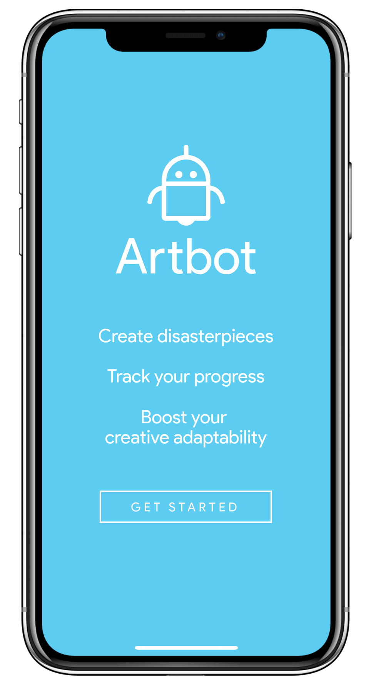
Artbot
Medium-Fi
Prototype
–
Team Articulate

Slide 2
Artbot
Mission Statement
Tasks
UI Changes
Major Design Changes
Task Flows
Prototype Overview
Figma
Limitations

Slide 3
Artbot Antagonistic, artful companion
We set out to tackle the dreaded problem artists of all levels face during the creation process – the block.
The block is when artists become too attached to their work but are unable to see a path forward in their work that satisfies them.
Artbot attempts to free artists from this mode of thinking using a gameified approach coupled with long-term check-ins.

Slide 4
Mission Statement:
Artbot is designed to boost your creative adaptability.

Slide 5
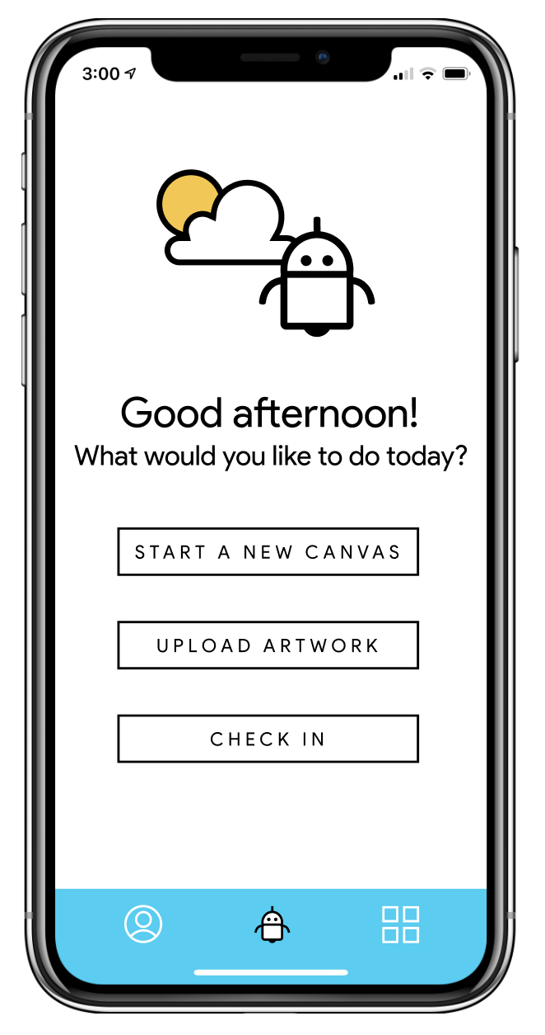
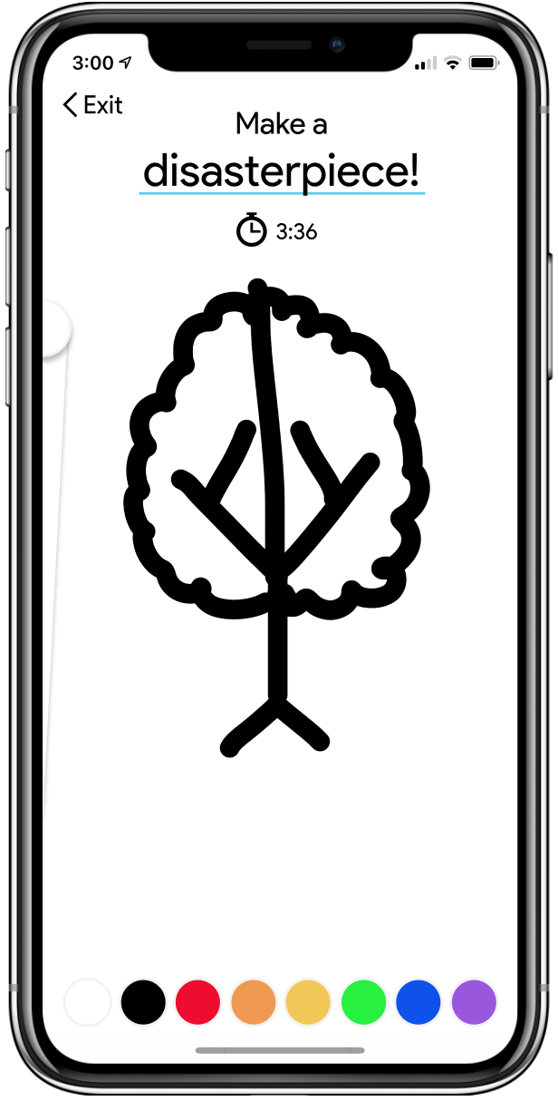
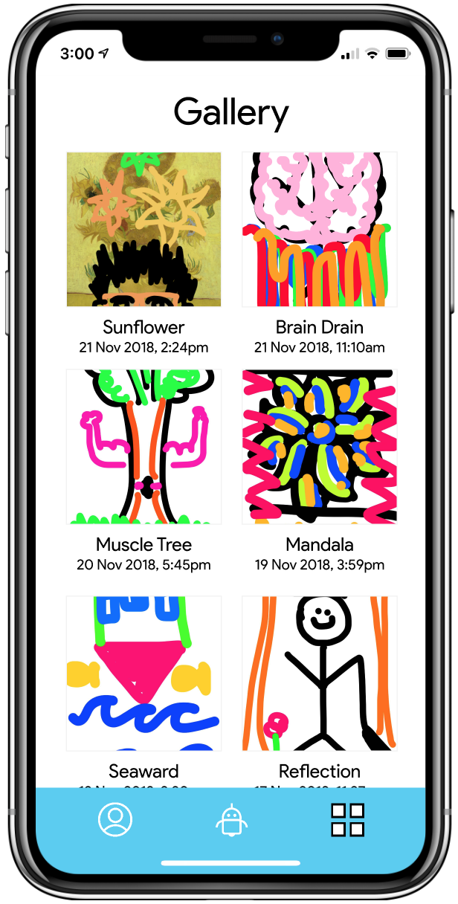
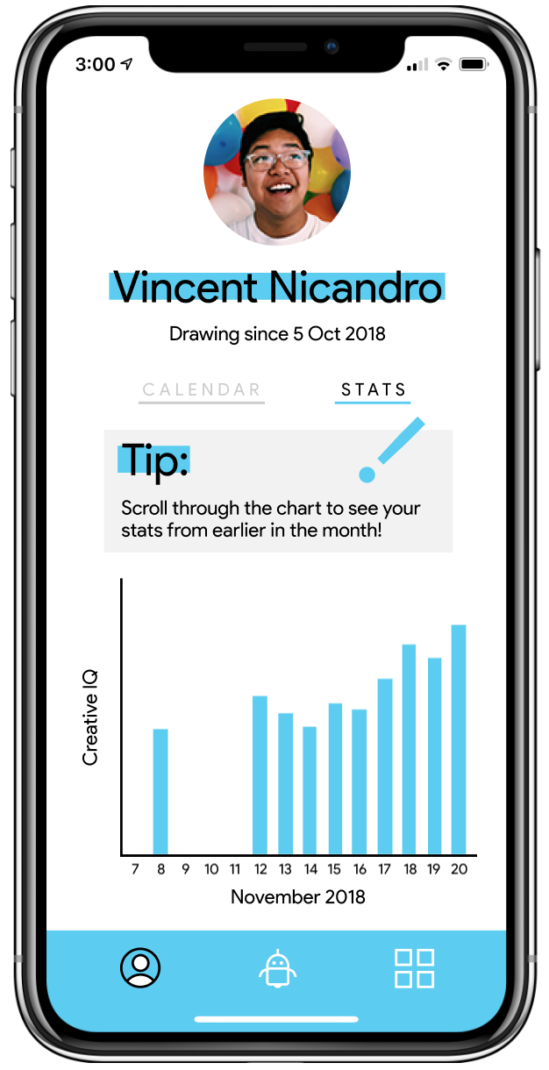
Home Screen: A Preview
Task One
Task Two
Task Three
Home

Slide 6
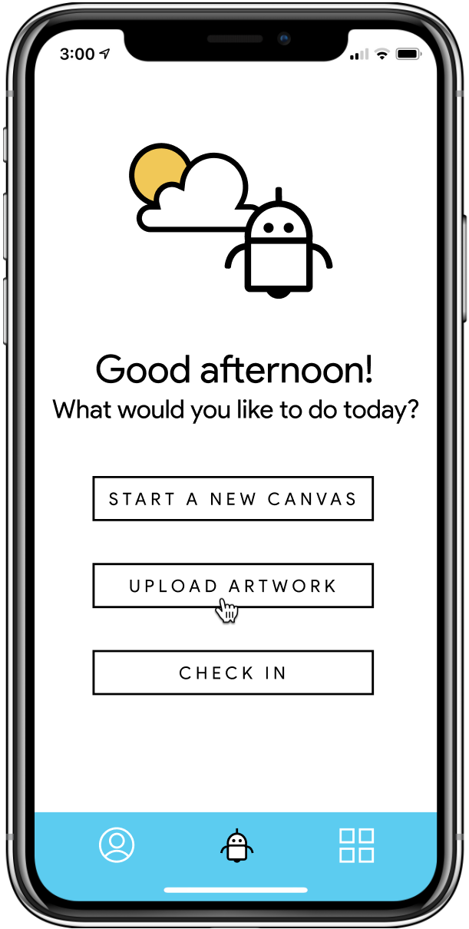
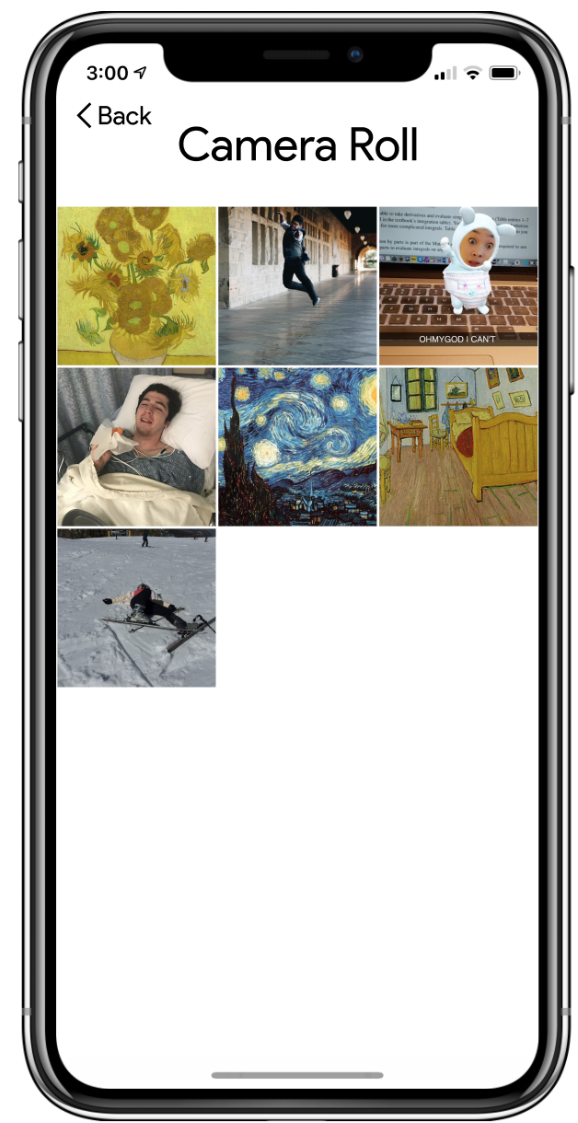
Task One: Create a new project
Choose from your own photos
or a blank canvas.
Notes:
On the menu screen, you can either select START A NEW CANVAS or UPLOAD ARTWORK to create a new project. UPLOAD ARTWORK then takes you to your camera roll.

Slide 7
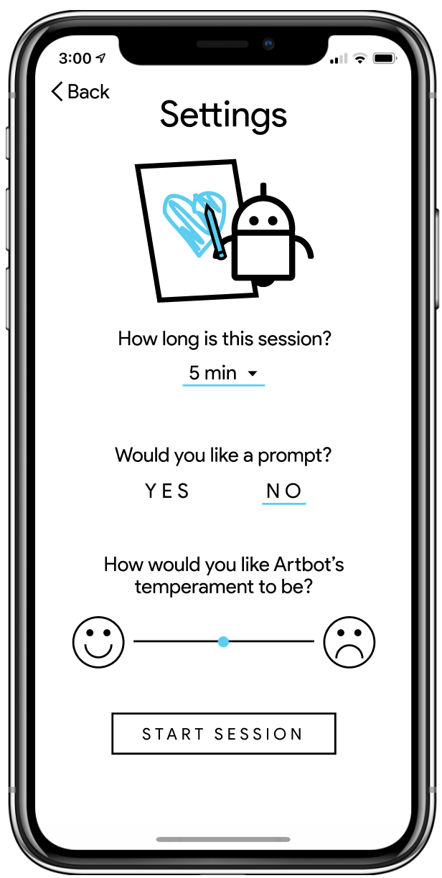
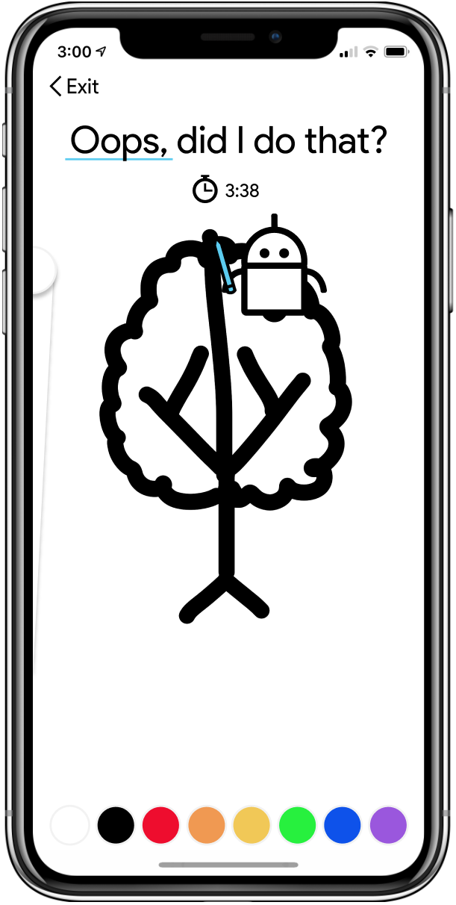
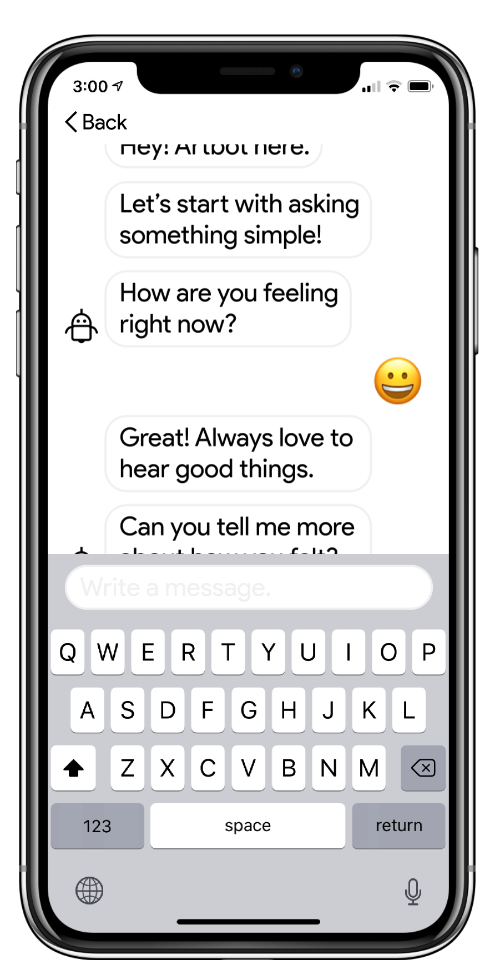
Task One: Create a new project
Pick your settings,
create,
and give feedback.
Notes:
You can customize how ArtBot will work, then you create with ArtBot, and finally you can opt-in to give ArtBot feedback. While this task has the most screens, it is what the app is centered around and thus it is our simple task.

Slide 8
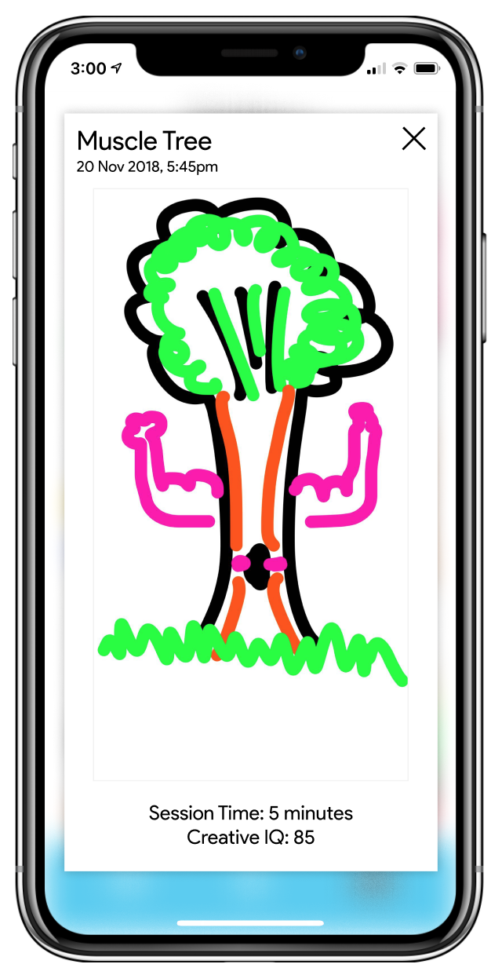
Task Two: Find previous disasterpieces
Find artwork you previously created.
Notes:
On the main page, you can press the bottom right button to view your gallery. Clicking on an image will enlarge it for more information. This is our medium task.

Slide 9
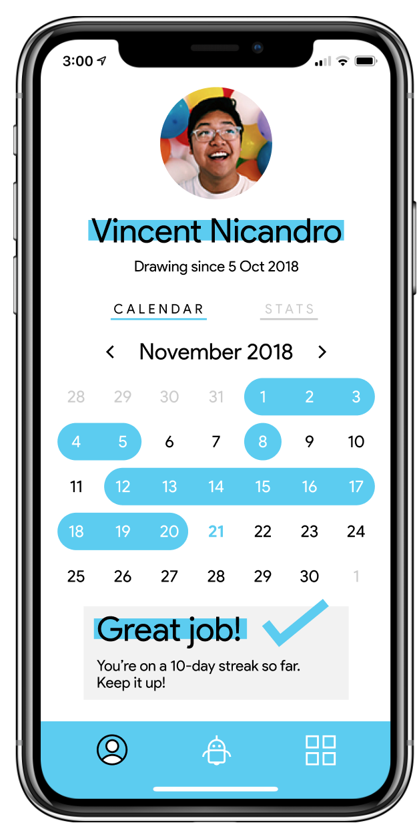
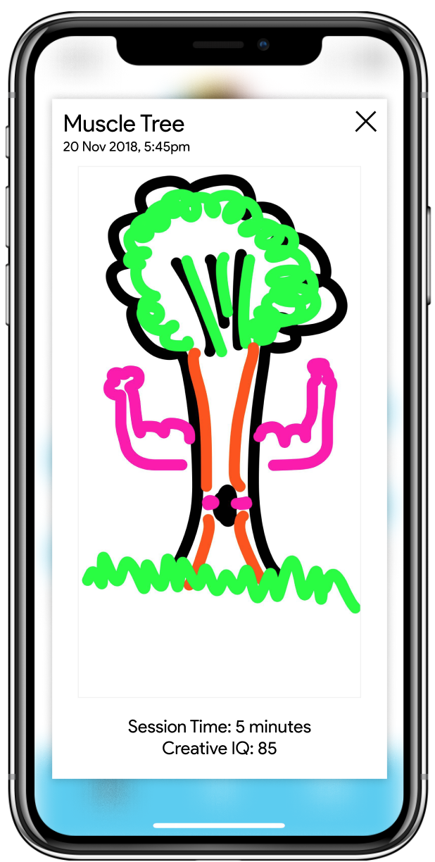
Task Three: Check and monitor your Creative IQ
Monitor your disasterpiece and progress on any available date.
Notes:
The left button on the main page is your profile, here you have two data visualization formats and if you select a date you can view the art you created with more info. This is our more complex task.

Slide 10
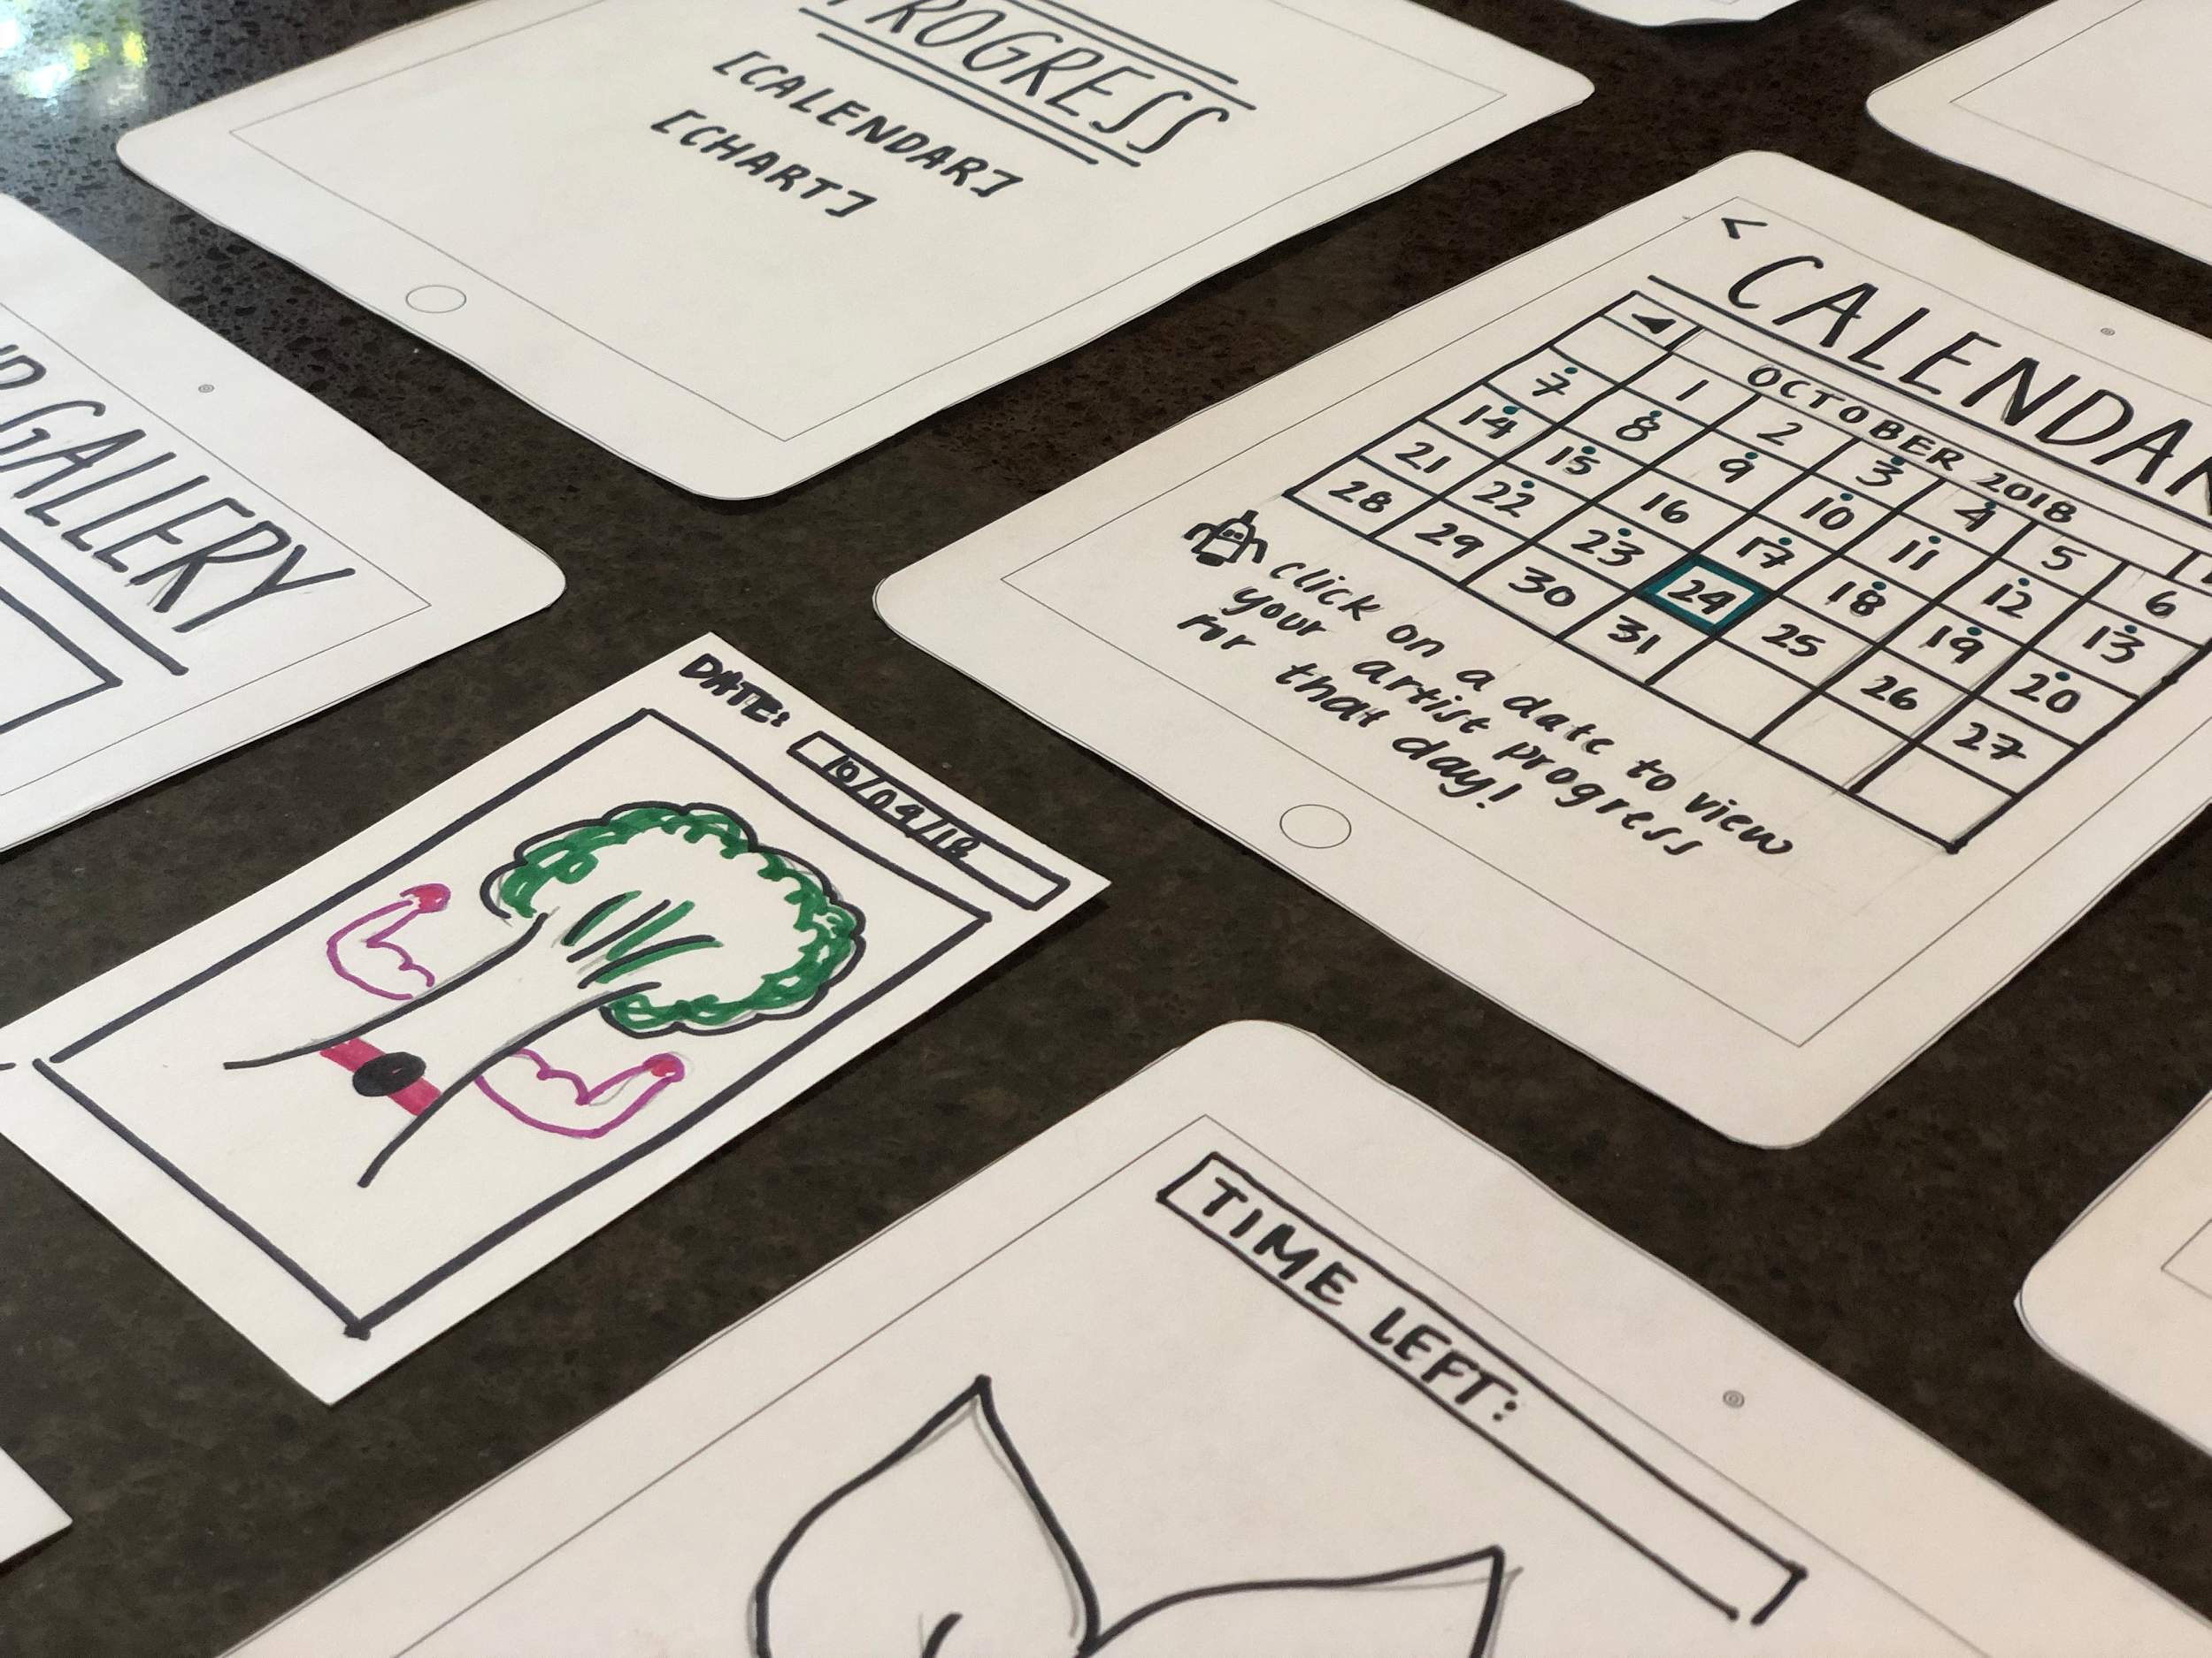
UI Changes
Changed Feedback form to Chatbot & Separated Chatbot as own Task
Added a Navigational Toolbar.to assist with switching to and from screens.
Settings now more intuitive

Slide 11
Check-In
Post-Disasterpiece Feedback has now become an optional chatbot feature
Available from the home screen

Slide 12
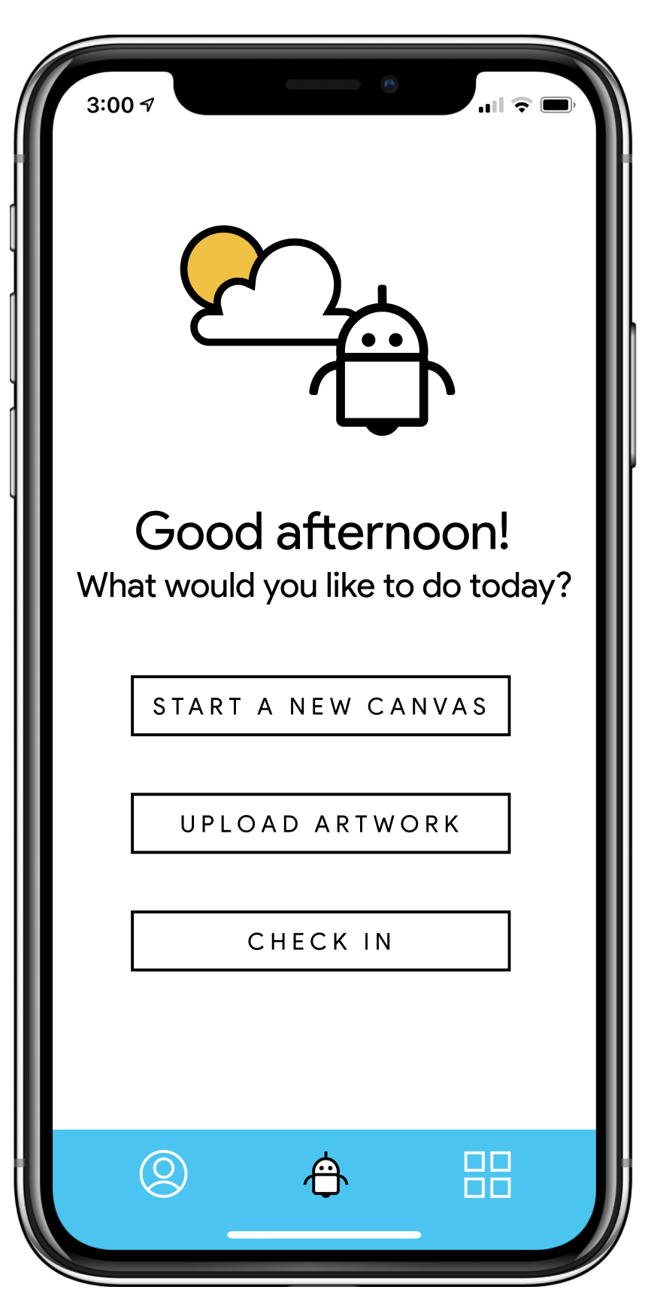
Navigational Toolbar
Implemented a Navigational Toolbar.
Reduces steps to reach different app screens

Slide 13
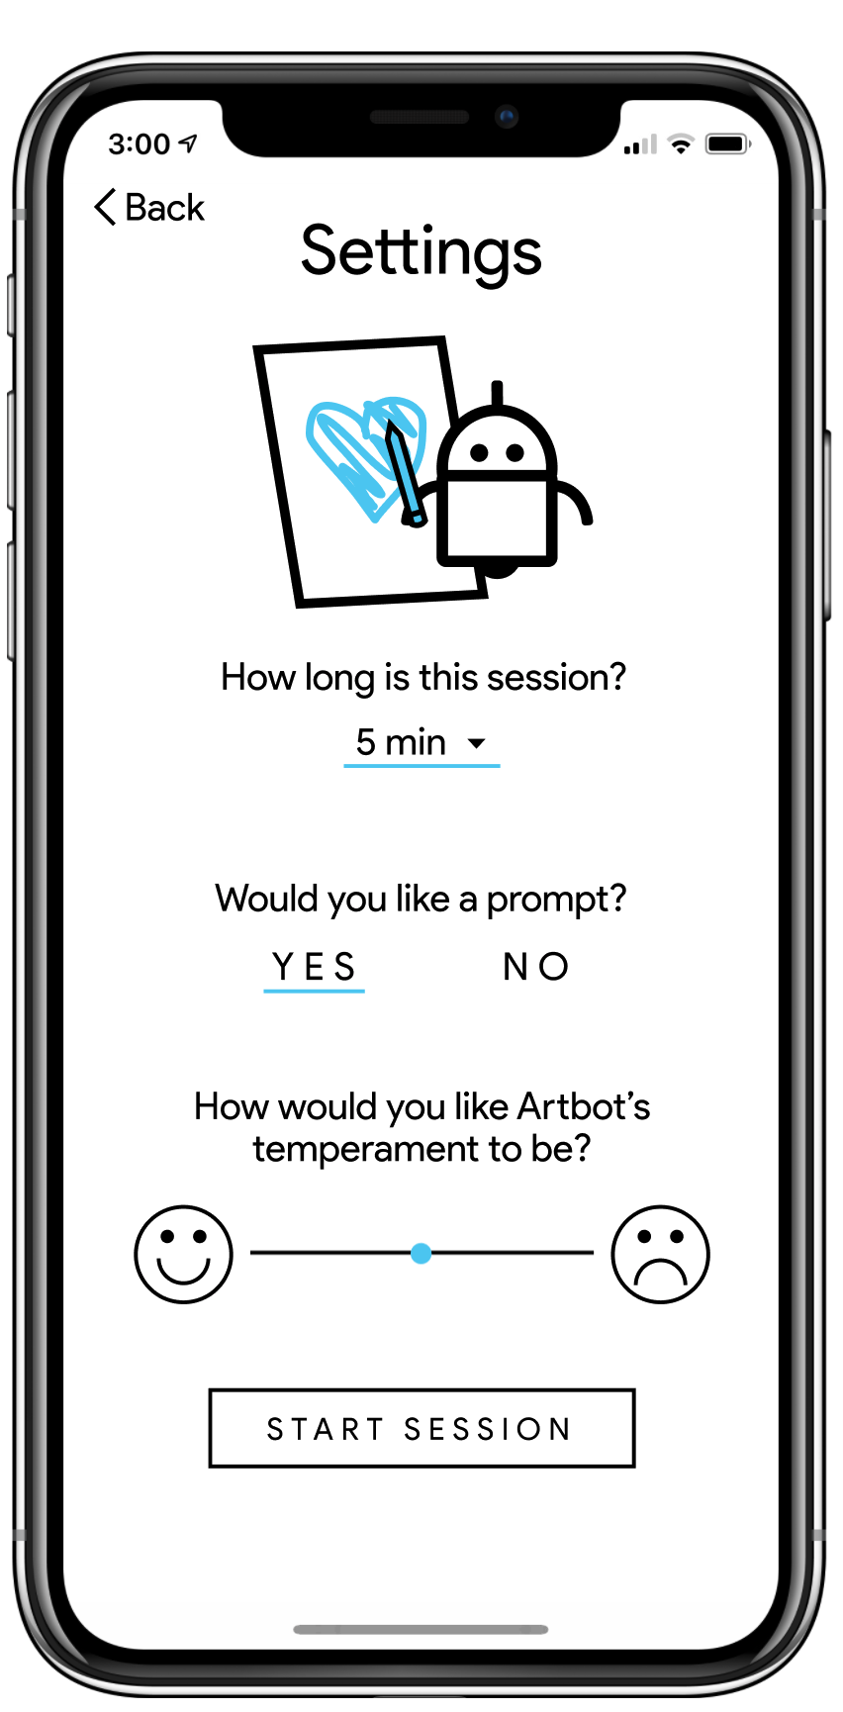
Settings Page
Artbot changed from specific details to slider
Prompt offered instead of supplied

Slide 14
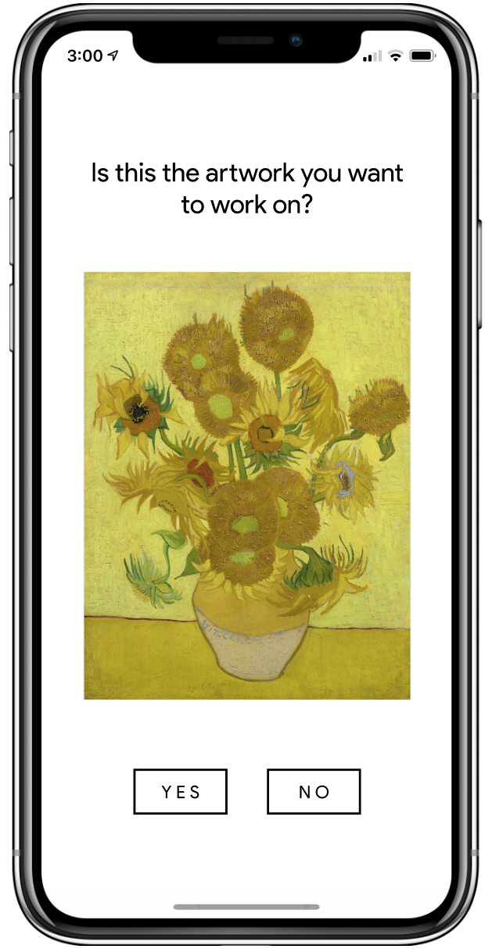
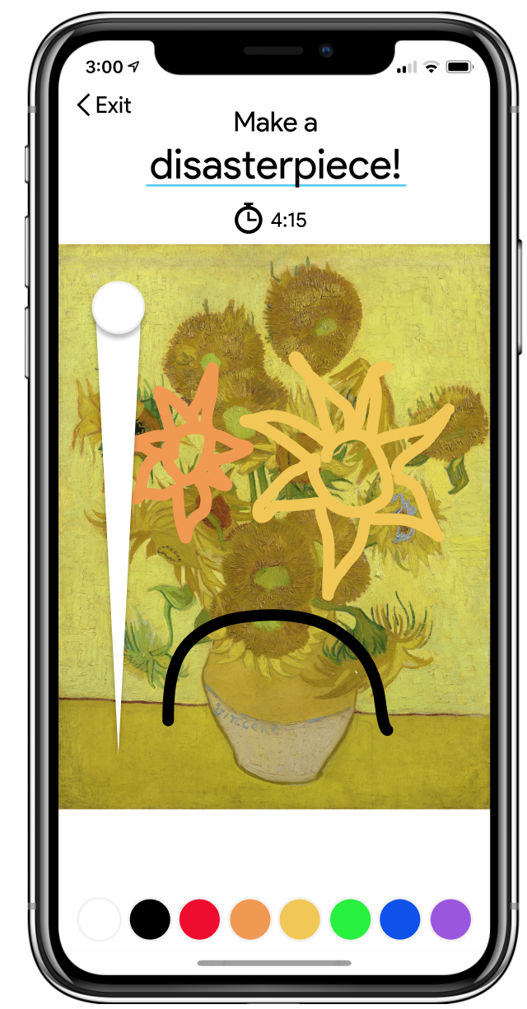
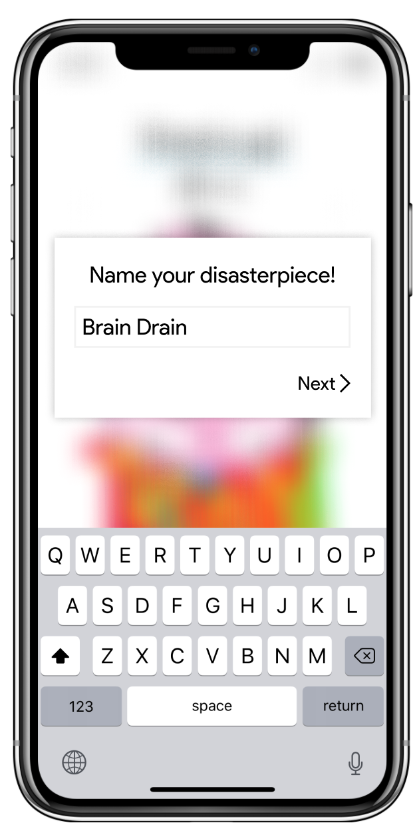
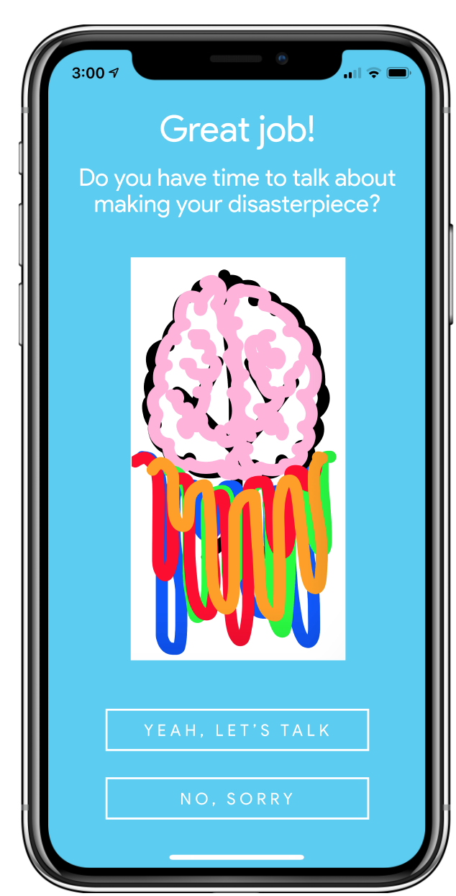
Task Flow: Create a new project
Notes:
On the menu screen, you can either select START A NEW CANVAS or UPLOAD ARTWORK to create a new project. UPLOAD ARTWORK then takes you to your camera roll. You then adjust the settings on ArtBot. Then you create your art while ArtBot interrupts until you run out of time. Then you name your artwork. You are asked if you want to give feedback and if you select yes then you talk with the chat bot. If you select no, ArtBot says that’s ok and you can always check in from the menu!

Slide 15
Task Flow: Find previous disasterpieces
Notes:
On the menu screen, select the bottom right button. You can then scroll through your gallery and click on an image for more information.

Slide 16
Task Flow: Check and monitor your Creative IQ
Notes:
On the menu screen, select the bottom left button. This will take you to your profile. You can use the top buttons to switch visualizations and then click on a day to view the artwork.

Slide 17
Prototype Overview
PROS
Easy to make consistent display assets throughout prototype
Great transitions.convenient for our app
Got pretty far without using Wizard of Oz techniques.
CONS
Couldn’t simulate drawing,, our core feature of Artbot
Needed to hardcode. most of the prototype
If you aren’t well versed in Figma, there is a steep learning curve.
Figma

Slide 18
Limitations/Tradeoffs
We could keep a majority of our interface, but couldn’t actually implement drawing with Figma
All interactions in the prototype are click based due to the nature of Figma
Since we had to fake the drawing task, the users step into a simulated experience, rather than their own

Slide 19
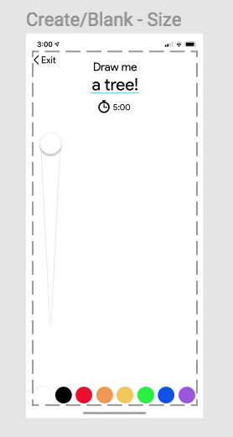
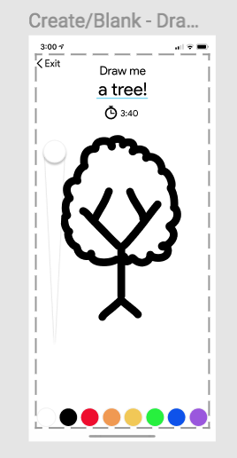
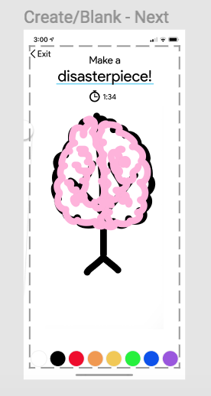
Wizard of Oz - Click to Draw
Since we couldn’t implement a drawing option, in order to “draw”, the user clicks on the screen and the art work will magically appear.

Slide 20
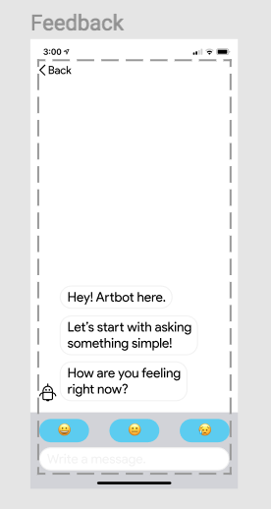
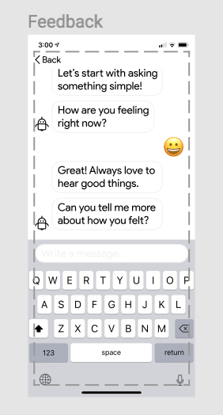
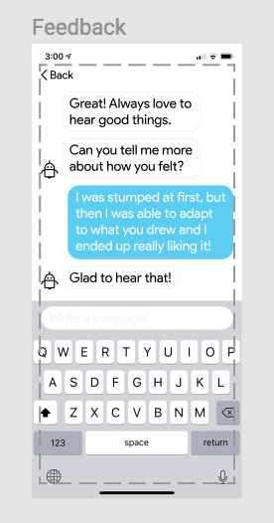
Wizard of Oz - Feedback Chatbot
Since we couldn’t implement the feedback chatbot, the user clicks on the screen and the user can observe a feedback conversation with Artbot.

Slide 21
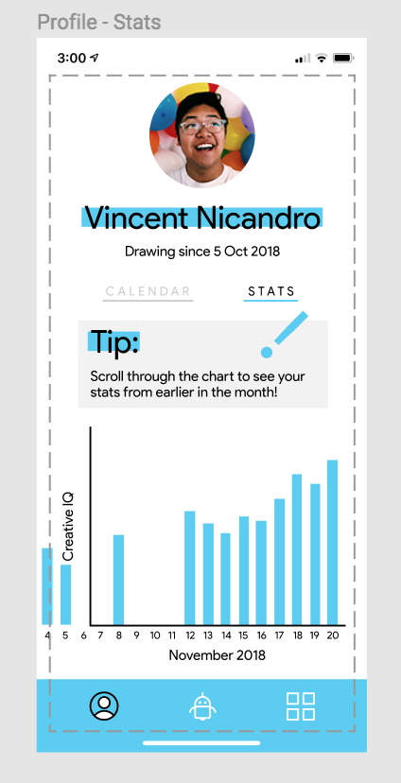
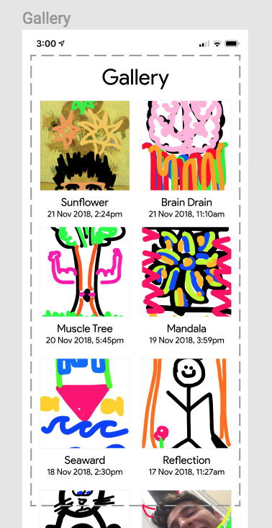
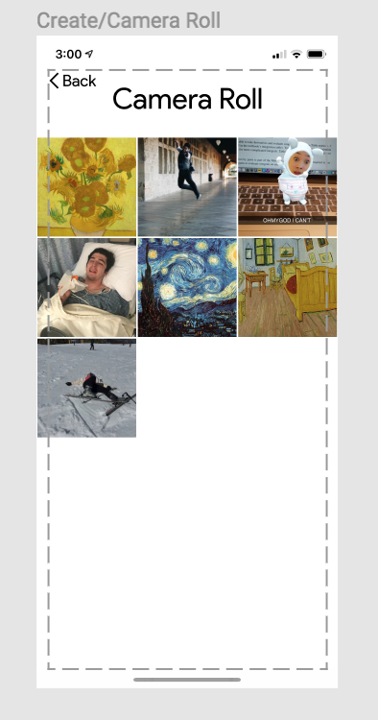
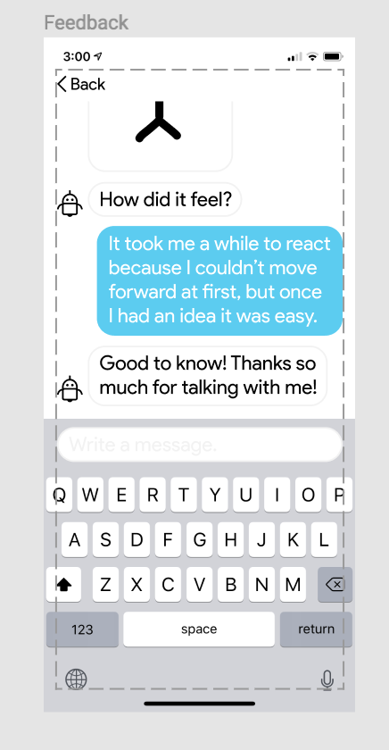
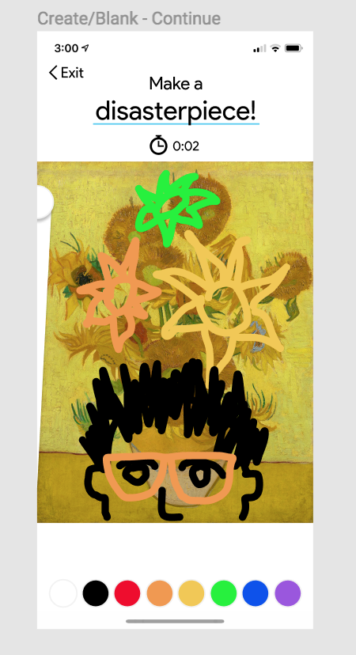
Hard Coded Data
To facilitate interactions between ArtBot and the user, we hardcoded user data (pictured below) to allow the user to explore the app already in progress.
Statistics
Gallery
Camera Roll
Chatbot
Drawing

Slide 22
Thanks!
love, the articulate team
Zach Goodale
zgoodale@stanford.edu
Lexi Stein
lexi@stanford.edu
Vincent Nicandro
nicandro@stanford.edu
Casey Wong
wongcs@stanford.edu

